Slide 1


Understanding Linear Regression
Linear regression is a supervised machine learning algorithm that predicts continuous outcomes by finding relationships between variables. It's widely used in forecasting, finance, and data analysis.

Slide 2

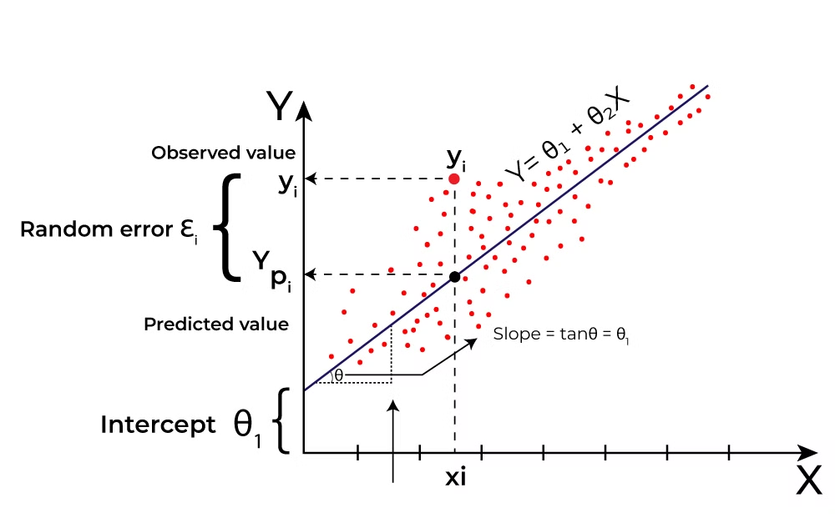
What is Linear Regression?
1
Supervised Learning Algorithm
2
Continuous Output
Predicts continuous variables based on independent input variables.
Maps data points with optimized linear functions for prediction on new datasets.
3
Linear Relationship
Computes relationships between dependent and independent variables using linear equations.

Slide 3




Real-World Example
House Age
Location
Room Count
Older houses may have different pricing patterns based on condition and historical value.
Proximity to amenities and neighborhood quality significantly impact house prices.
More rooms typically increase a property's market value and appeal.

Slide 4
Why Linear Regression Matters
Interpretability
Simplicity
Versatility
Clear coefficients illustrate each variable's influence on outcomes. This enhances understanding of relationships.
Transparent and easy to implement. Serves as a foundation for more advanced algorithms.
Applicable across many fields including finance, healthcare, and marketing.

Slide 5
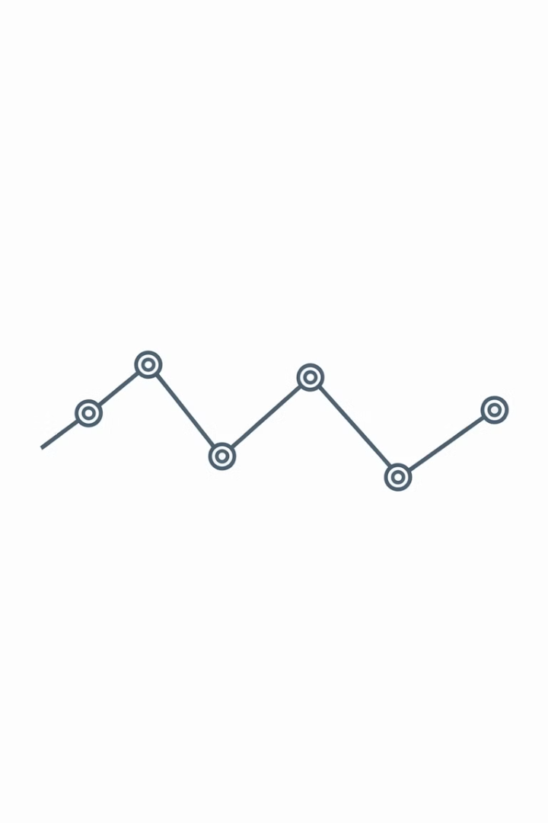
The Best Fit Line
Definition
Purpose
The line that minimizes error between predicted and actual values.
Represents the relationship between dependent and independent variables.
Indicator
The slope shows how much the dependent variable changes for a unit change in the independent variable.

Slide 6
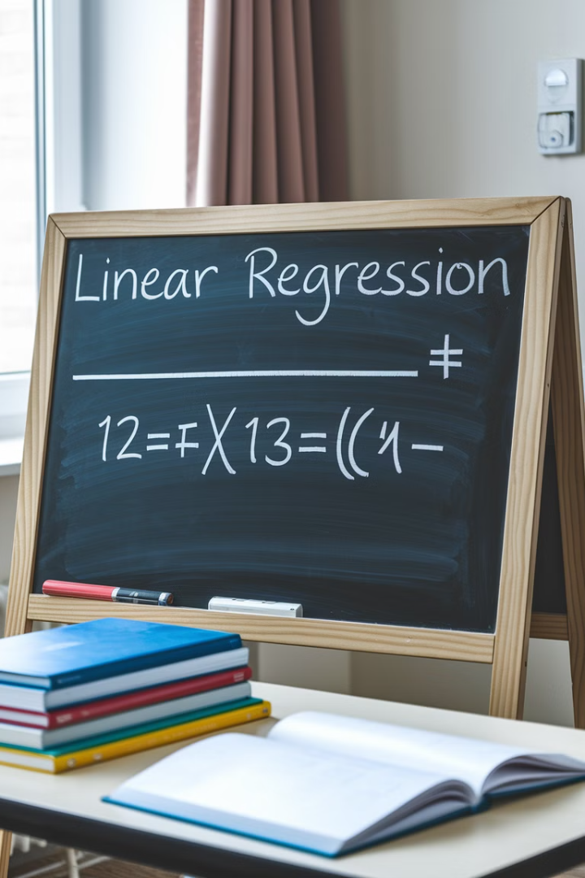



Linear Regression Formula
Formula
Y = θ₁ + θ₂X
Variables
Y is the dependent variable (target). X is the independent variable (predictor).
Parameters
θ₁ is the intercept. θ₂ is the coefficient or slope.

Slide 7



Hypothesis Function
Independence
2
Observations should be independent from each other.
Linearity
1
Assumes linear relationship between variables.
Prediction
3
ŷᵢ = θ₁ + θ₂xᵢ

Slide 8

Finding the Best Parameters
Objective
Find values of θ₁ and θ₂ that give the best-fit line.
Method
Minimize error between predicted values and actual values.
Formula
Minimize (1/n)∑(ŷᵢ-yᵢ)²

Slide 9

Types of Linear Regression
1
Simple Linear Regression
One independent variable and one dependent variable.
2
Multiple Linear Regression
Multiple independent variables and one dependent variable.

Slide 10
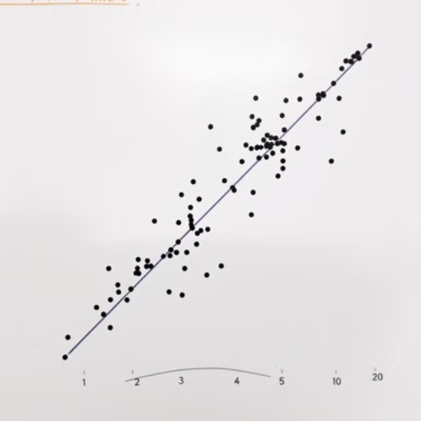

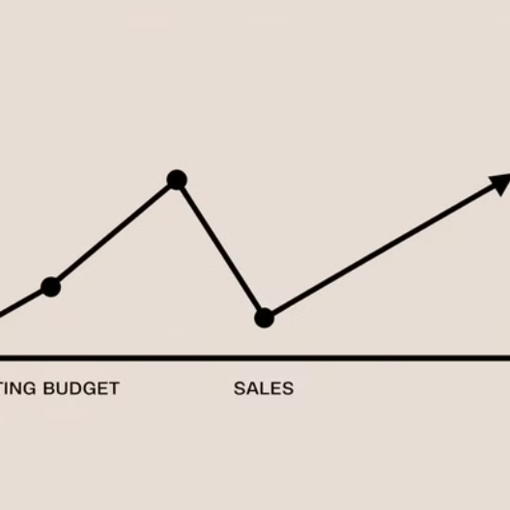
Simple Linear Regression
Formula: y = β₀ + β₁X where Y is dependent variable, X is independent variable, β₀ is intercept, and β₁ is slope.

Slide 11




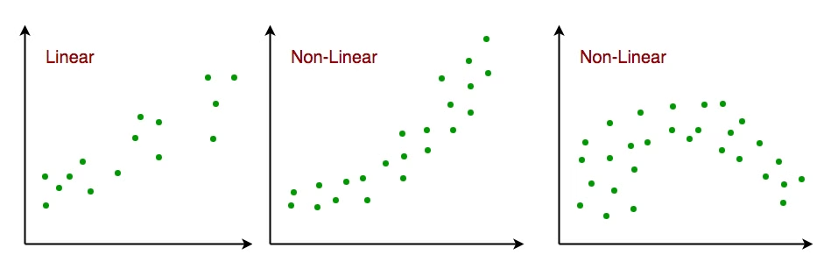
Simple Linear Regression Assumptions
Normality
1
Residuals should be normally distributed.
2
Homoscedasticity
Variance of errors is constant across all levels.
3
Independence
Observations are independent of each other.
4
Linearity
Variables have a linear relationship.

Slide 12

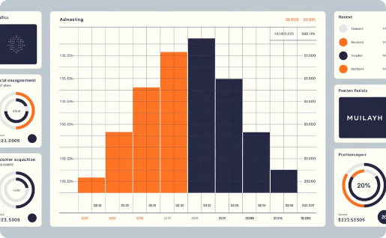

Simple Linear Regression Use Cases
Student Performance
Marketing ROI
Health Metrics
Each study hour increases exam scores by 5 points on average.
Each additional dollar spent on advertising increases sales by $10.
Predicting weight based on height for health assessments.

Slide 13
Multiple Linear Regression
Formula
1
y = β₀ + β₁X₁ + β₂X₂ + ... + βₙXₙ
Variables
2
Y is dependent, X₁...Xₙ are independent variables.
Parameters
3
β₀ is intercept, β₁...βₙ are slopes for each variable.

Slide 14

Multiple Linear Regression Assumptions
1
No Multicollinearity
No high correlation between independent variables.
2
Additivity
Effects of predictor variables are consistent regardless of other variables.
3
Feature Selection
Carefully select relevant independent variables to avoid overfitting.
4
Avoid Overfitting
Model shouldn't fit training data too closely to maintain generalization.

Slide 15
Multicollinearity
Definition
Detection: Correlation Matrix
Detection: VIF
Statistical phenomenon where two or more independent variables are highly correlated.
Variance Inflation Factor above 10 suggests multicollinearity is present.
Examine correlations between variables. High correlations (near 1 or -1) indicate multicollinearity.

Slide 16

Multiple Linear Regression Use Cases
1
Real Estate
Predicting property prices based on location, size, bedrooms, and amenities.
2
Finance
Forecasting stock prices using interest rates, inflation, and market trends.
3
Agriculture
Estimating crop yields based on rainfall, temperature, and soil quality.
4
E-commerce
Analyzing sales impact from price, promotions, and seasonal trends.

Slide 17

Cost Function
Purpose
Measures error between predicted and actual values
Common Cost Function
Mean Squared Error (MSE)
Formula
(1/n)∑(ŷᵢ-yᵢ)²
Goal
Minimize cost function to find optimal parameter values

Slide 18
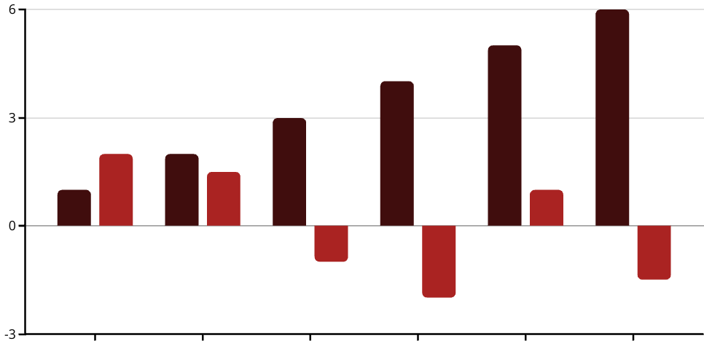
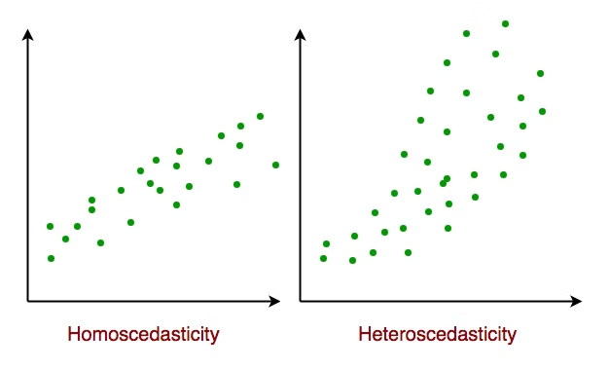
Homoscedasticity in Linear Regression
X Value
Residual
Homoscedasticity means residuals have constant variance across all levels of independent variables. This is a key assumption for reliable results.

Slide 19





Implementing Linear Regression
Collect Data
Gather relevant data with dependent and independent variables.
Analyze Relationships
Check if variables have linear relationships and meet assumptions.
Build Model
Train algorithm to find optimal parameters by minimizing error.
Evaluate & Deploy
Test accuracy using metrics like R-squared and use for predictions.

Slide 20




Key Takeaways
Best Fit Line
Assumptions
The goal is finding the line that minimizes error between predicted and actual values.
Linearity, independence, homoscedasticity, and normality are crucial for reliable results.
Simple vs Multiple
Versatile Applications
Simple uses one independent variable, while multiple uses several variables to predict outcomes.
Used in finance, real estate, healthcare, marketing, and many other fields.
2
3
1
4

